Slide 1
Marin County
Complete Count Committee Meeting
January 27, 2020

Slide 2
Agenda
Welcome
Introductions
Timeline
Census updates
Resources
Tracking and reporting
Action Teams
Notes:
Stephanie

Slide 3
Introductions
Purpose of Meeting
Get everyone up to speed
Build action teams
Share resources
Briefly share the following:
Name
Org
HTC Group(s)
Activities
Notes:
Stephanie

Slide 4
2020 Census Timeline
Count everyone once, only once, and in the right place.
Plan
Educate
Motivate
Activate
Evaluate
Notes:
Kristin
Goal: count everyone once, only once, and in the right place
MOTIVATE: Motivate people to respond on their own (self respond) primarily through the internet.. The goal is to make it easy for people to respond. You are our trusted messengers to motivate and activate to increase participation.
ACTIVATE: Campaign to make it easy for people to respond anytime, anywhere via multiple modes (internet, paper, or telephone). Use real time data to adjust outreach and messaging to respond to response rates (SWORD)
April 1: National observance of the census By this date, every home will receive an invitation to participate in the 2020 Census
Non-Response Follow Up: May 13 - July 31
July 31: Last day households can self respond online
Final Plan: 9/30 - comprehensive report on all outreach efforts throughout the campaign, including evaluation of lessons learned, best practices, and recommendations for 2030
Data on counts given to POTUS by Dec. 31, 2020
Release counts for redistricting by April 1, 2021

Slide 5
2020 Census Timeline
Motivate
Feb - March
Activate
March - April
NRFU
April - July
CCC begins community organization efforts
Self Response: 3/12 - 4/30
(Respond online & via telephone)
Mailing census forms begins:
#1: 3/16 - 3/23 sent to homes
#2: 3/20 - 3/27 sent to non-respondents
Census advertising campaign
Mailing #3: 3/30-4/6 postcards sent
Homeless Count: 3/30 - 4/1
Service Based Enumeration (transitory locations)
Group Quarters Count
April 1 - National Census Day
Mailing #4: 4/12 - 4/19 letter & paper sent
Mailing #5: 4/23 4/30 “It’s not too late” postcard
Local census follow up in person if no response
CCC urges households who do not respond to cooperate with census takers
Last day to respond online: 7/31
Notes:
Kristin
MOTIVATE:
CCC begins community organization mobilization in support of 2020 Census and encourage self-response
Motivate people to respond on their own (self respond) primarily through the internet.
Self Response: March 12 - April 30
March 12: Households can start responding online and via telephone
Mailing of census questionnaire will go out in staggered waves
Census advertising campaign
ACTIVATE
Mailing of census forms to non-respondents continues. Round 3 (a postcard)
Homeless count: The Census Bureau will count people who are experiencing homelessness over these three days. As part of this process, the Census Bureau counts people in shelters, at soup kitchens and mobile food vans, on the streets, and at non-sheltered, outdoor locations such as tent encampments.
Service Based Enumeration begins in March - for transitory locations like RV parks and campgrounds, tent cities, marinas, hotels)
Census takers will begin visiting college students who live on campus, people living in senior centers, and others who live among large groups of people (College/university student housing (i.e., dorms, residence halls, etc.), nursing homes, group homes, prisons in March
April 1 - National Census Day
Mailing #4: letter and paper questionnaire sent to those who have not yet responded
NRFU
Mailing #5: An “It’s not too late” postcard is sent to those who have not responded.
Census takers will begin visiting homes that haven't responded to help make sure everyone is counted
CCC continues to urge households who do not respond to cooperate with census takers

Slide 6
Historically Undercounted Communities
Latinos
African Americans
Asian/Pacific Islander
Native Americans and Tribal
Middle Eastern/North Africans
Immigrants and Refugees
Farmworkers
People with Disabilities
Homeless Individuals/Non Conventional Housing
Veterans
Seniors/Older Adults
Children 0-5
Households with Limited English Proficiency
Renters
A population may be hard to identify, hard to reach, hard to persuade, hard to interview, or perhaps all of these.
Notes:
Stephanie
Source: https://census.ca.gov/california-htc/

Slide 7
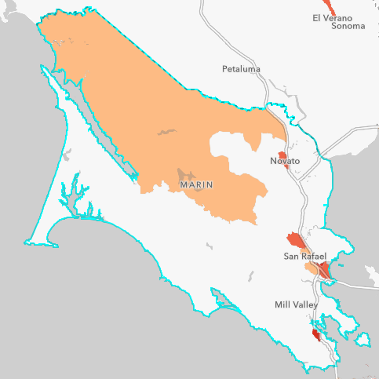
Marin Hard To Count
Outreach focus is communities and individuals least likely to respond based on the California Hard to Count (HTC) Index.
West Marin (Tracts 1311, 1321, 1322, 1330)
HTC Index: 20 - 42
Pop. 2,991
Novato (Tract 1022.03)
HTC Index: 49
Pop. 5,737
Canal (Tract 1122.01)
HTC Index: 105
Pop. 7,700
Hard to Count (HTC) Index
14 demographic, housing, and socioeconomic variables
Each variable scored from 0-11 scale
Total score range: 0-154 (easiest to hardest to count)
California HTC Index Average: 37
Terra Linda (Tract 1082)
HTC Index: 50
Pop. 6,376
Marin City (Tract 1290)
HTC Index: 79
Pop. 2,686
Canal (Tract 1122.02)
HTC Index: 66
Pop. 4,607
Notes:
Stephanie
Source: https://cacensus2020.maps.arcgis.com/apps/webappviewer/index.html?id=48be59de0ba94a3dacff1c9116df8b37

Slide 8
Census Activity
Since countywide census outreach and education efforts began in earnest in February 2019, the Marin Census Staff Team, led by Stephanie McNally of Canal Alliance, have conducted the following community outreach efforts:
60 presentations
65 community meetings
27 trainings
10 census jobs workshops
Notes:
Stephanie

Slide 9
Support State and Federal Government
Census Bureau Recruiting Team
Census Bureau Partnership Specialist
Census Bureau Service Based Enumeration
California Census Office
United Way Bay Area Region 3 CBO
Notes:
Stephanie

Slide 10
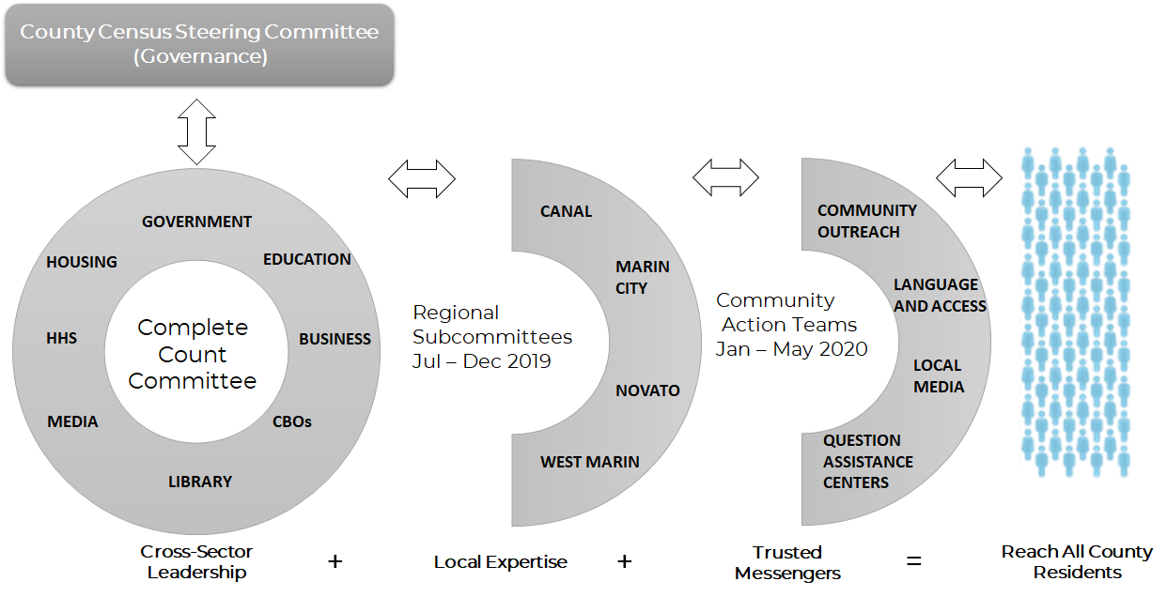
Marin Complete Count Committee Structure
Notes:
Stephanie

Slide 11
Subcommittees to Action Teams
Communications
Marin City
Based on census outreach activities
Each team will have members from each HTC region
Each team will have members from each HTC group
Members are able to execute
Programmatic Outreach
San Rafael
Marin Complete Count Committee
Events/Tabling
Novato
Canvassing
West Marin
QAC/QAK
Notes:
Stephanie

Slide 12
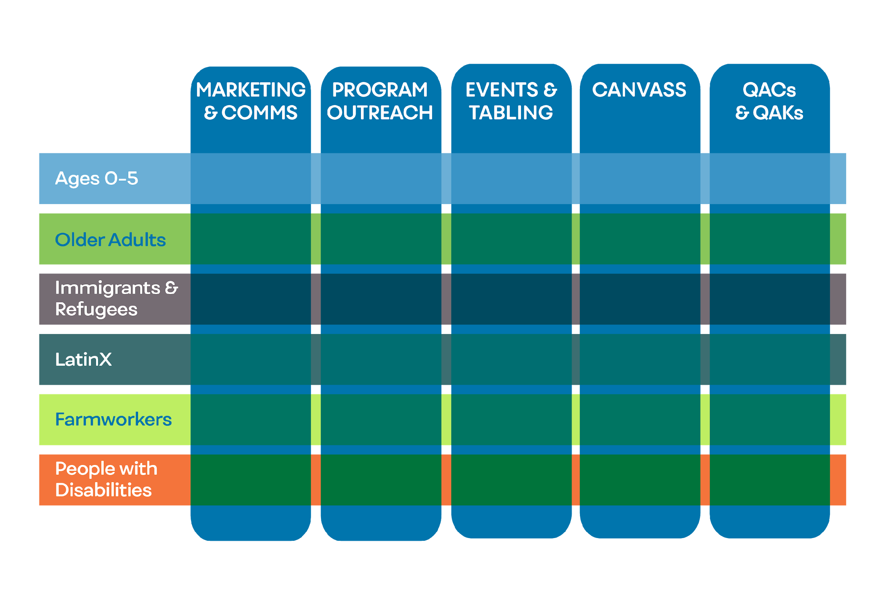
Action Teams
Notes:
Jenifer will talk about website, printed materials, and what we will be providing partners

Slide 13
Sharing Resources
Printed Materials
Posters & Signage
Advertising
Outdoor
Print
Online
Media Coverage
Editorial
News
Radio
TV
Speaker Pool for Events
Social
Media
Content
Notes:
Jenifer will talk about website, printed materials, and what we will be providing partners

Slide 15
Sneak Preview of New Campaign Theme

Slide 16
Resource Links To Be Posted and Shared by Email
MARIN CENSUS 2020.Org – Resources For Partners
UNITED WAY BAY AREA - Census Page COMMUNITY ACTION - Census Resource Page
FIRST FIVE ASSOC of CALIFORNIA - Social Media Toolkit
NALEO – Hagase Contrar
U.S. CENSUS BUREAU YouTube Channel

Slide 17
Other Activities To Be Coordinated via Action Teams
MEDIA RELATIONS
PAID ADVERTISING – Billboards, Marin Transit, Print
VOLUNTEERS
EVENTS
QACs | QAKs

Slide 18
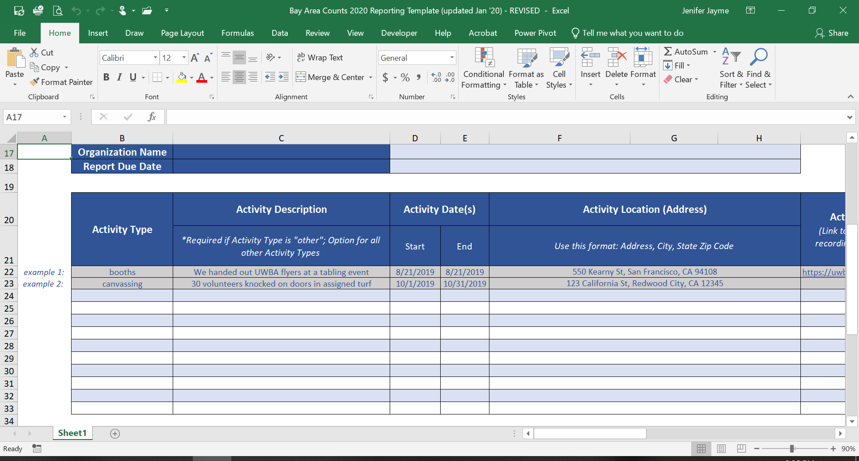
Reporting
We Suggest: Use UWBA Excel Sheet To Track Your Activities
Submit your events to MarinCensus2020.org/Events for central tracking
Notes:
Jenifer will talk about UWBA reporting template (spreadsheet) and website reporting portal

Slide 19
Next Steps
Identify staff from your organization that will be working with action teams
Provide contact information for action teams
Determine format and timing of Action Team meetings

Slide 20
MarinCensus2020.org
Thank you

